Slide 1

Hypothesis Testing and its application

Slide 2

1
What is a Hypothesis?
2
What is Hypothesis Testing
3
Steps to perform the test
4
Types of hypothesis tests

Slide 3

What is a Hypothesis?
In simple terms, it is a statement that can be tested by using the existing data
Statement 1: Apple price in this area is moderate.
This is not a hypothesis
Statement 2: Apple price in this area is Rs.150/Kg
This is a hypothesis

Slide 4
What is a Hypothesis Testing?
It is a statistical test which is used to test a hypothesis. Based upon the result, we decide, whether to accept or reject the hypothesis.
Null hypothesis (H_{o}) : Apple price in this area is equal to Rs.150/Kg
Alternative hypothesis (H₁ or H_{A}) : Apple price in this area is not equal to Rs.150/Kg

Slide 5



Testing of Hypothesis
We collect information of apple price from a total of 100 supermarkets, shops and street vendors and calculate the mean apple price.
Case 1: Average apple price from 100 samples comes out to be Rs. 155/Kg
Seems our null hypothesis is correct!
Case 2: Average apple price from 100 samples comes out to be Rs. 180/Kg
What conclusion can we draw?

Slide 6
Testing of Hypothesis
Population data:
Mean (µ_{o}) : Rs. 150/Kg
Standard deviation(σ) : 1.5
Sample data:
Mean (x̅) : Rs.180/Kg
Standard deviation(s) : 1.1
p-value (the deciding criteria): It is a numerical value between 0 and 1 which quantifies the confidence by which we would decide whether the null hypothesis can be rejected or not. Closer the p-value to 0, greater is our confidence to reject the claim of null hypothesis. But how much closer?!
The general threshold is 5%!

Slide 7
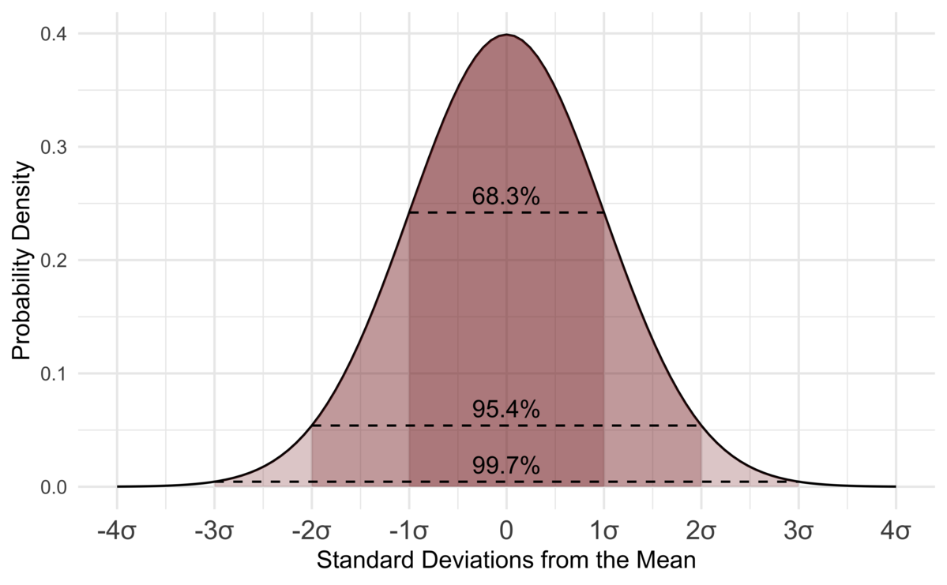

Calculation of p-value
Z-score = ( x̅ - µ_{o} ) / (σ/ $\sqrt{n}$)
Z-value or Z-score gives us the value of how many standard deviations the sample mean is away from the mean of a standard normal distribution, either on the positive or negative side.

Slide 8
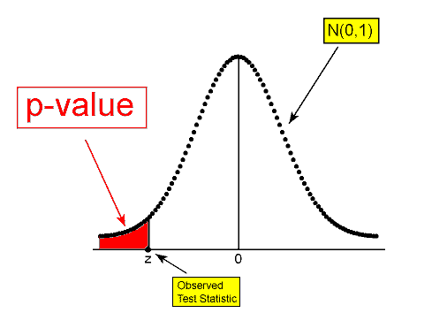
Calculation of p-value
p-value is simply the area under the curve in the standard normal distribution.

Slide 9
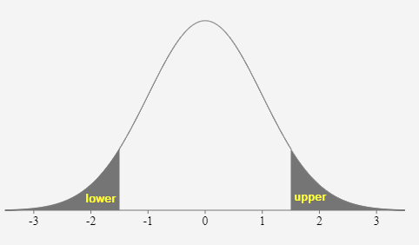
Types of Hypothesis Testing
There are 3 types of hypothesis testing:
Lower tailed or Left tailed test
Upper tailed test or Right tailed test
Two-tailed test
Null hypothesis (H_{o}) : Apple price in this area is equal to Rs.150/Kg
Lower-tailed test
Alternative hypothesis (H₁) : Apple price in this area is less than Rs.150/Kg
Upper-tailed test
Alternative hypothesis (H₁) : Apple price in this area is greater than Rs.150/Kg
Two-tailed test
Alternative hypothesis (H₁) : Apple price in this area is not equal to Rs.150/Kg

Slide 10
Hypothesis Testing types based upon sample size and population variance
Z - Test
T - Test
When we know the population variance and when the sample size is large, n >= 30
When we don’t know the population variance or when the sample size is small , n < 30

Slide 11
Let’s now see it in action!

